Slide 1

Ch.02 Storing and Retrieving Data
Siva R Jasthi
ICS325 – Internet Application Development
Information and Computer Sciences
Metropolitan State University

Slide 2
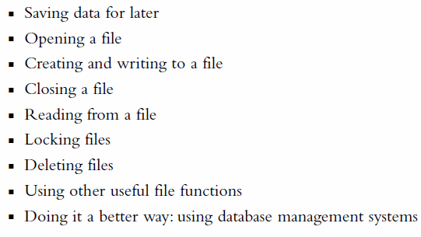
Key Topics
Reading from:
Files
Database
APIs/WebServices
Write to:
Files
Database

Slide 3
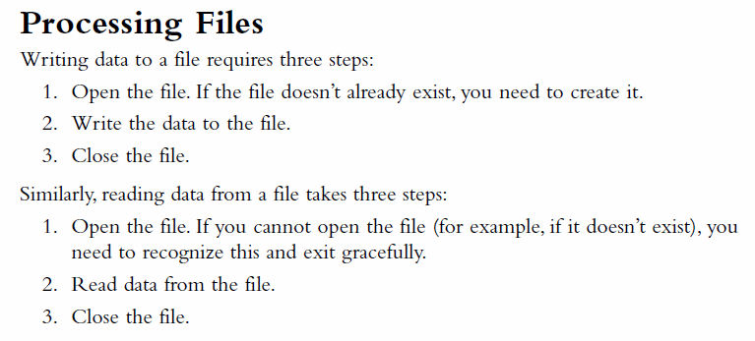
Processing Files

Slide 4
PHP file I/O functions
function name(s) | category
fopen() fclose() | for opening and closing a file
file ( ) fread( ) fwrite( ) file_get_contents() file_put_contents() | reading/writing entire files
feof() | For finding whether the contents in a file reached the end of file (while reading)

Slide 5
PHP file I/O functions (contd.)
function name(s) | category
basename( ) file_exists( ) filesize( ) fileperms( ) filemtime( ) is_dir( ) is_readable( ) Is_writable( ) disk_free_space( ) | asking for information

Slide 6
PHP file I/O functions (Contd.)
function name(s) | category
copy( ) rename( ) unlink( ) chmod( ) chgrp( ) chown( ) mkdir( ) rmdir( ) | manipulating files and directories
glob( ) scandir( ) | reading directories

Slide 7
Difference between file( ) and file_get_contents
contents of foo.txt | file("foo.txt") | file_get_contents ("foo.txt")
Hello how are you? I'm fine | array( "Hello\n", #0 "how are\n", #1 "you?\n", #2 "\n", #3 "I'm fine\n" #4 ) | "Hello\n how are\n you?\n \n I'm fine\n"
file(): Reads entire file contents into an array of lines.
file_get_contents(): Reads entire file contents into a string.
NOTE: The array returned by file will be separated by newline, but each element will still have the terminating newline attached, so you will still need to watch out for that.

Slide 8
Reading/writing an entire file
# reverse a file
$text = file_get_contents("poem.txt");
$text = strrev($text);
file_put_contents("poem_rev.txt", $text); PHP
file_get_contents returns entire contents of a file as a string
file_put_contents writes a string into a file, replacing any prior contents

Slide 9
Appending to a file
# add a line to a file
$new_text = “PS: I am thinking of you";
file_put_contents("poem.txt", $new_text, FILE_APPEND);
Existing content | After appending
Hey! How are you? When are you coming? | Hey! How are you? When are you coming? PS: I am thinking of you
Notes:
file_put_contents can be called with an optional third parameter
appends (adds to the end) rather than replacing previous contents

Slide 10
Reading directories
function | description
scandir( ) | returns an array of all file names in a given directory (returns just the file names, such as "myfile.txt")
glob( ) | returns an array of all file names that match a given pattern (returns a file path and name, such as "foo/bar/myfile.txt")
Notes:
glob can filter by accepting wildcard paths with the * character

Slide 11
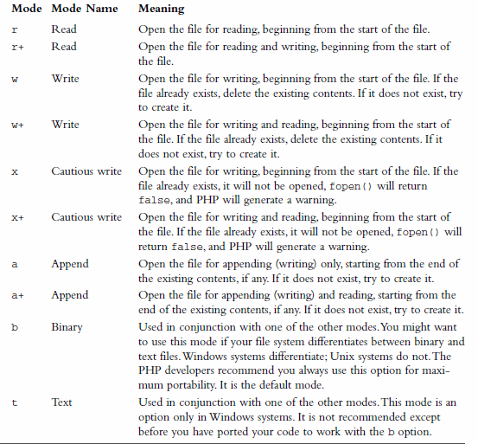
fopen() modes

Slide 12
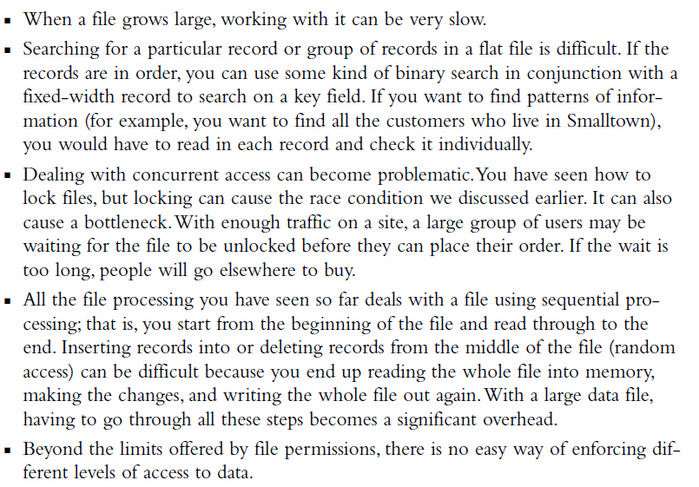
Problems with Using Flat Files

Slide 13
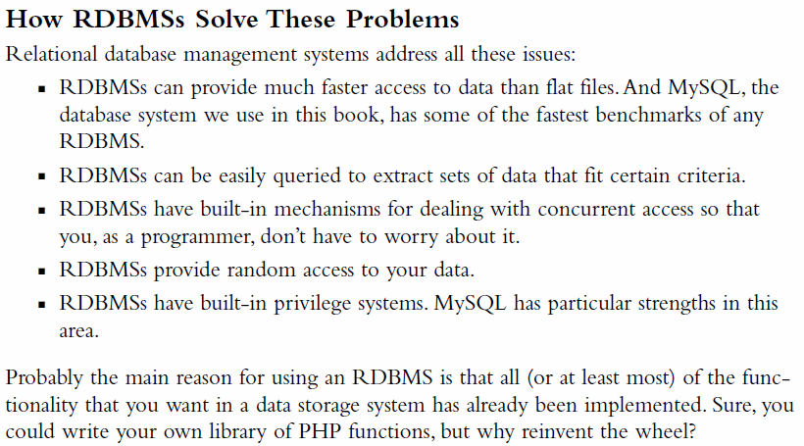
How RDBMS Solve These Problems

Slide 14
References
PHP Manual http://php.net/manual/en/language.exceptions.php
W3 Schools
http://www.w3schools.com/php/php_exception.asp

